Slide 1
CSE 3400 - Introduction to Computer & Network Security (aka: Introduction to Cybersecurity) Lecture 9 Shared Key Protocols – Part II
Ghada Almashaqbeh
UConn
From Textbook Slides by Prof. Amir Herzberg
UConn

Slide 2
Outline
Handshake protocol extensions.
Key distribution centers.
Improving resilience to key exposure.
2

Slide 3
Handshake Protocols Extensions
3

Slide 4
Authenticated Request-Response Protocols
Beside authenticating entities, these protocols authenticate the exchange of a request and a response between the entities.
Required properties:
Request authentication.
The request was indeed sent by the peer.
Response authentication
The response was indeed sent by the peer.
No replay.
Every request/response was received at most the number of times it was sent by the peer.
4

Slide 5
Authenticated Request-Response Protocols
Five variants:
2PP-RR
2RT-2PP
Counter-based-RR
Time-based-RR.
Key-exchange.
5

Slide 6
2PP-RR
A three-flow nonce-based protocol.
Significant drawback:
The request is sent by the responder and the initiator sends the response.
So initiator must wait for a request rather than sending it!!
6
Notes:
6
(c) Amir Herzberg, http://AmirHerzberg.com, Bar Ilan University
11/13/11

Slide 7
2RT-2PP
A four-flow nonce-based protocol.
Mainly fixes the drawback of 2PP-RR (see previous slide).
7
Notes:
7
(c) Amir Herzberg, http://AmirHerzberg.com, Bar Ilan University
11/13/11

Slide 8
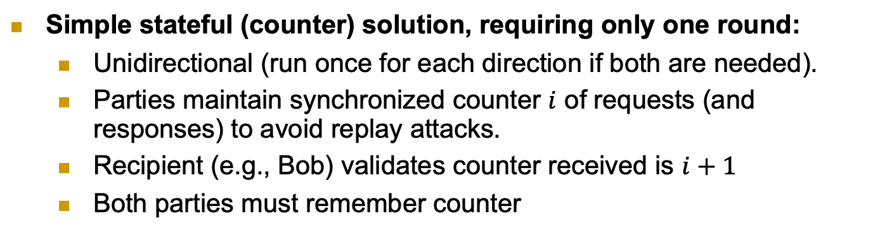
Counter-Based Authenticated RR
Simple stateful (counter) solution, requiring only one round:
Unidirectional (run once for each direction if both are needed).
Parties maintain synchronized counter $i$ of requests (and responses) to avoid replay attacks.
Recipient (e.g., Bob) validates counter received is $i+1$
Both parties must remember counter
8
Notes:
8
(c) Amir Herzberg, http://AmirHerzberg.com, Bar Ilan University
11/13/11

Slide 9
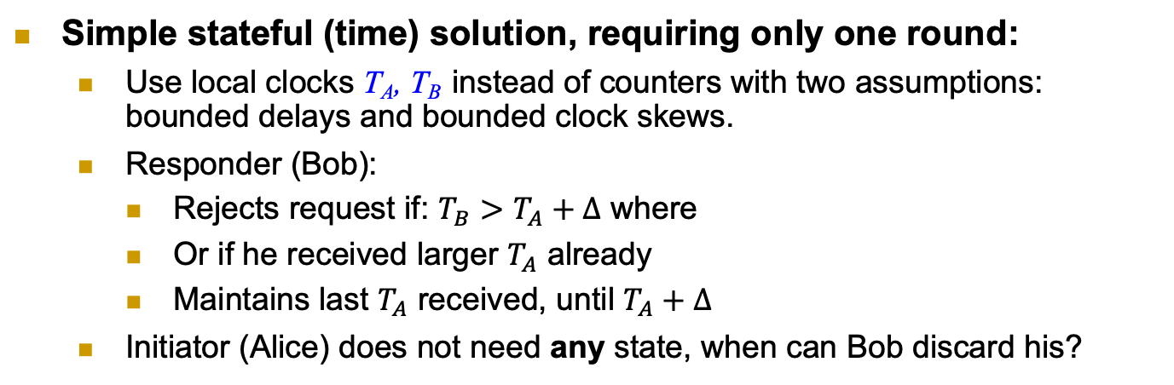
Time-Based Authenticated RR
Simple stateful (time) solution, requiring only one round:
Use local clocks T_{A}, T_{B} instead of counters with two assumptions: bounded delays and bounded clock skews.
Responder (Bob):
Rejects request if: $T_{B}>T_{A}+Δ$ where
Or if he received larger $T_{A}$ already
Maintains last $T_{A}$ received, until $T_{A}+Δ$
Initiator (Alice) does not need any state, when can Bob discard his?
Remember T_{A}
9
Notes:
9
(c) Amir Herzberg, http://AmirHerzberg.com, Bar Ilan University
11/13/11

Slide 10
2RT-2PP with Confidentiality
Secure connection: authentication, freshness, secrecy
Independent keys: for encryption k.e, for authentication: k.a
How can we derive them both from a single key k ?
k.e=PRP_{k}(“Encrypt”), k.a=PRP_{k}(“MAC”)
Hmm… same key encrypts all messages, in all sessions ☹
Can we improve security, by changing keys, e.g., btw sessions ?
Alice
Bob
A, N_{A}
N_{B}
E_{k.e}(req) , Mac_{k.a}(3 || A→B || N_{A} || N_{B} || E_{k.e}(req) )
E_{k.e}(resp) , Mac_{k.a}(4 || A←B ||N_{A} || N_{B} || E_{k.e}(resp))
10
Notes:
10
(c) Amir Herzberg, http://AmirHerzberg.com, Bar Ilan University
11/13/11

Slide 11
2PP Key Exchange Protocol
Independent session keys, e.g. k=PRF_{MK}(N_{A},N_{B})
Or, `directly’ for authentication and for encryption: k.e=PRF_{MK}(“Encrypt”, N_{A},N_{B}), k.a=PRF_{MK}(“MAC”, N_{A},N_{B})
Improves security:
Exposure of session key does not expose (long-term) ‘master key’ MK
And does not expose keys of other sessions
Limited amount of ciphertext exposed with each session key k
Later: reduce risk also from exposure of Master Key MK
Why a PRF is used instead of the MAC as before?
11
Notes:
11
(c) Amir Herzberg, http://AmirHerzberg.com, Bar Ilan University
11/13/11

Slide 12
Key Distribution Centers (KDCs) Establish a shared key between two or more entities, usually with the help of a trusted third party referred to as KDC
12

Slide 13
Key Distribution Center (KDC)
Will focus on three party protocols; Alice, Bob, and KDC.
KDC: shares keys with all parties (k_{A}, k_{B}…)
Goal: help parties (A, B) establish k_{AB}
We will study two protocols; simplified versions of:
The Kerberos protocol (secure) widely used in computer networks.
The GSM protocol (insecure) used by cellular networks.
13
Notes:
KDC = TGS (Ticket Granting Server) [Kerberos]

Slide 14
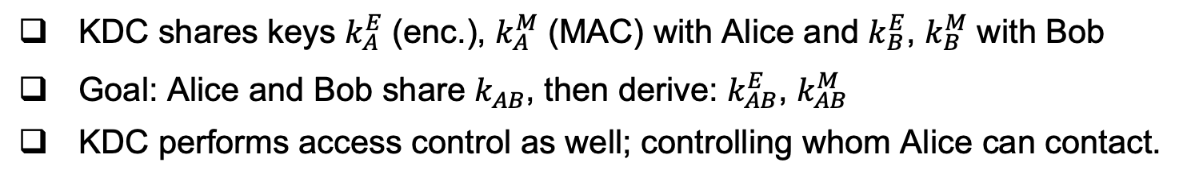
The Kerberos KDC Protocol
KDC shares keys $k_{A}^{E}$ (enc.), $k_{A}^{M}$ (MAC) with Alice and $k_{B}^{E}$, $k_{B}^{M}$ with Bob
Goal: Alice and Bob share $k_{AB}^{}$, then derive: $k_{AB}^{E}$, $k_{AB}^{M}$
KDC performs access control as well; controlling whom Alice can contact.
14

Slide 15
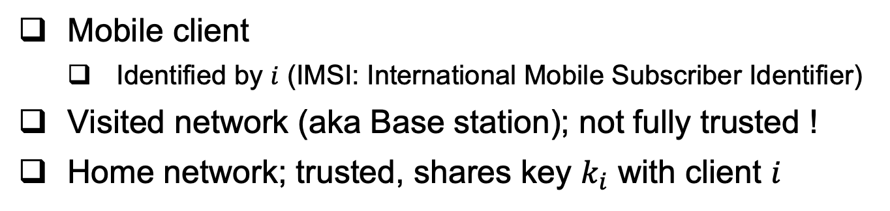
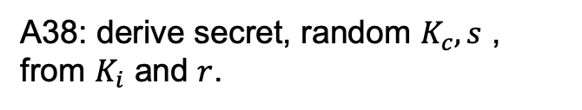
The GSM Handshake Protocol
Mobile client
Identified by $i$ (IMSI: International Mobile Subscriber Identifier)
Visited network (aka Base station); not fully trusted !
Home network; trusted, shares key $k_{i}$ with client $i$
A38: derive secret, random $K_{c}, s$ , from $K_{i}$ and $r$.
GSM spec: OWF, but really should be a PRF!
15

Slide 16
Example – Sending two messages
Kc is the session key
s is called a secret authenticator
A5: provide ‘pad’ for encryption
Several variants: A5/1 - `regular’
A5/2 - `weak’
A5/3 – more secure
Really should be a PRF!
ECC: error correcting code. Used to allow recovery from errors.
16

Slide 17
Attacks on GSM
We will explore two such attacks:
Visited network impersonation replay attack.
Downgrade attack.
17
Notes:
KDC = TGS (Ticket Granting Server) [Kerberos]

Slide 18
Visited-network Impersonation Attack
Note: does NOT
Impersonate mobile, only Visited network.
In the cryptanalysis phase, the attacker will try to obtain Kc based on the cyphertexts it collected in the eavesdropping phase (recall A5/1 and A5/2 are not secure)
18

Slide 19
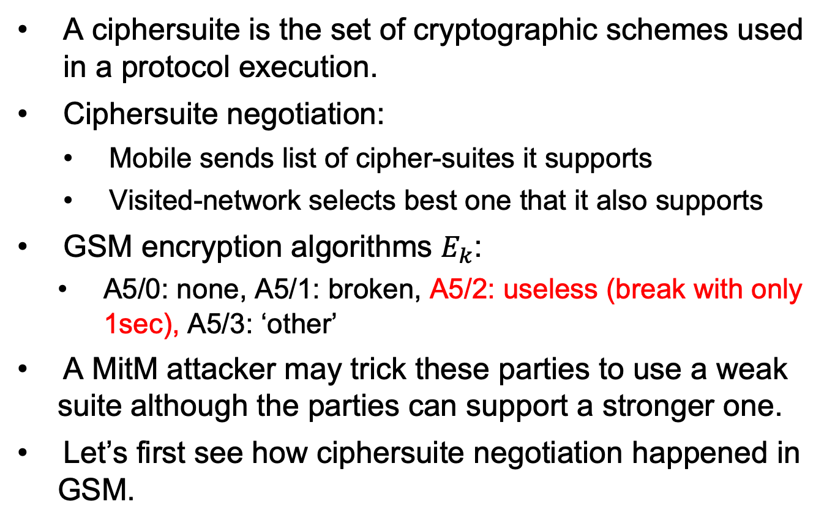
GSM Ciphersuites Downgrade Attack
A ciphersuite is the set of cryptographic schemes used in a protocol execution.
Ciphersuite negotiation:
Mobile sends list of cipher-suites it supports
Visited-network selects best one that it also supports
GSM encryption algorithms $E_{k}$:
A5/0: none, A5/1: broken, A5/2: useless (break with only 1sec), A5/3: ‘other’
A MitM attacker may trick these parties to use a weak suite although the parties can support a stronger one.
Let’s first see how ciphersuite negotiation happened in GSM.
19

Slide 20
Cipher mode messages, negotiation
Mobile sends list of supported ciphers
VN sends choice in: CIPHMODCMD
Cipher Mode Command
Mobile confirms by sending encrypted: CIPHMODCOM: cipher mode complete
If not received (in few msecs), VN disconnects
VN Acks: CIPHMODOK: cipher mode Ok
If not received, mobile resends CIPHMODCOM
20

Slide 21
GSM
Handshake,
With
Cipher-negotiation.
21

Slide 22
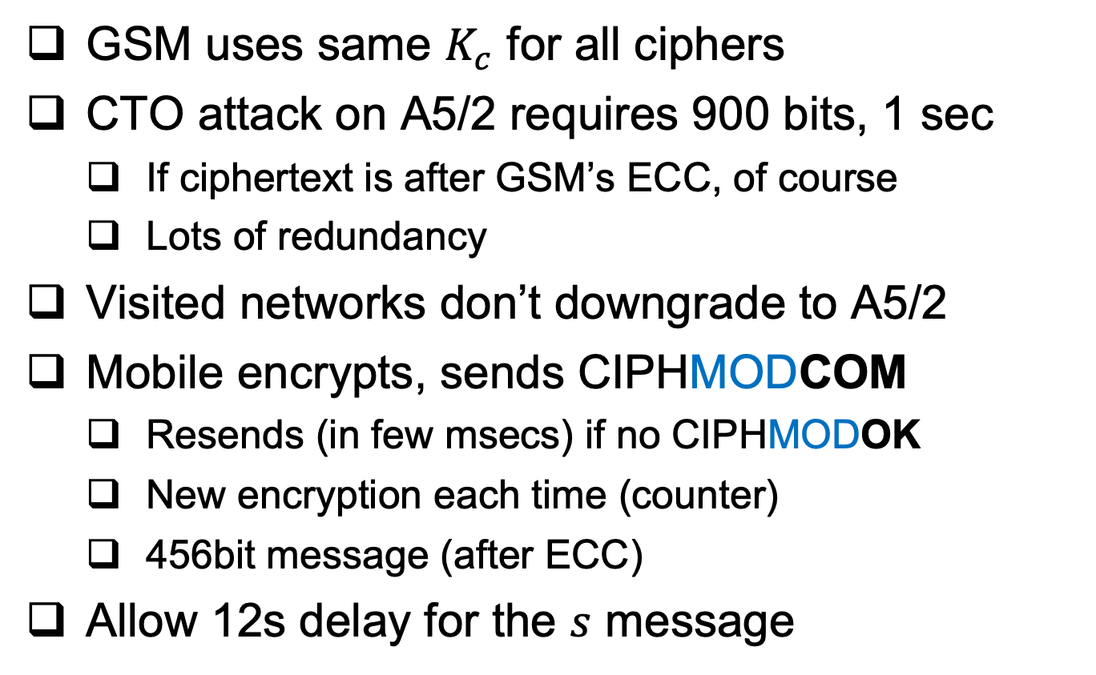
GSM ciphersuite facts: for fun and profit
GSM uses same $K_{c}$ for all ciphers
CTO attack on A5/2 requires 900 bits, 1 sec
If ciphertext is after GSM’s ECC, of course
Lots of redundancy
Visited networks don’t downgrade to A5/2
Mobile encrypts, sends CIPHMODCOM
Resends (in few msecs) if no CIPHMODOK
New encryption each time (counter)
456bit message (after ECC)
Allow 12s delay for the $s$ message
22

Slide 23
Real Downgrade Attack
Works even if VN insists to use A5/1; attacker tricks client to use A5/2. That suffices, since GSM uses same key for all cryptosystems!
The 12 sec delay allows that!
Retransmissions of CIPHERMODCOM provides the attacker with more than 900 bits of ciphertext!
23

Slide 24
Improving Resiliency to Key Exposure
24

Slide 25
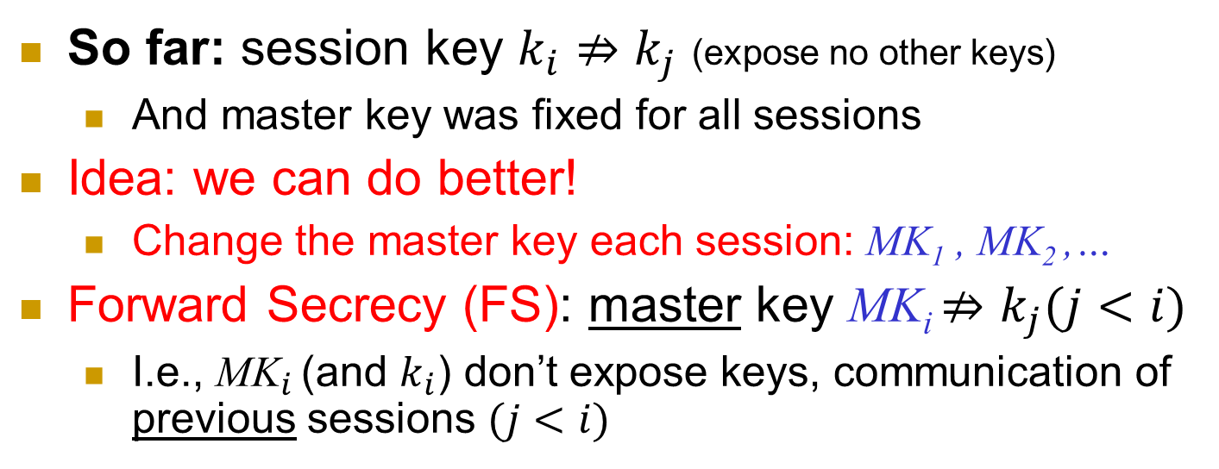
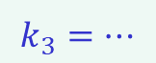
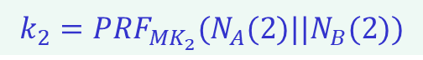
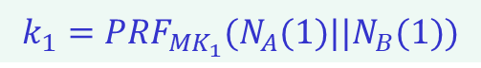
Forward Secrecy I
So far: session key $k_{i}⇏k_{j}$ (expose no other keys)
And master key was fixed for all sessions
Idea: we can do better!
Change the master key each session: MK₁ , MK₂ ,…
Forward Secrecy (FS): master key MK_{i} $⇏k_{j}(j<i)$
I.e., ${\text{MK}}_{i}$ (and $k_{i}$) don’t expose keys, communication of previous sessions $(j<i)$
Secure MK₁
Keys Exposed
MK₂
Stays insecure
MK₃
$$k_{1}={PRF}_{{MK}_{1}}(N_{A}(1)||N_{B}(1))$$
$$k_{2}={PRF}_{{MK}_{2}}(N_{A}(2)||N_{B}(2))$$
$$k_{3}=…$$
25
Notes:
25
(c) Amir Herzberg, http://AmirHerzberg.com, Bar Ilan University
11/13/11
`Perfect’ is not really the right term… but that’s the commonly used term.

Slide 26

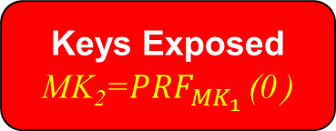
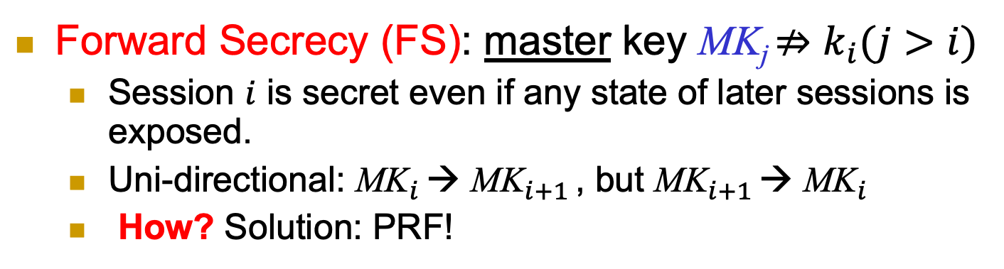
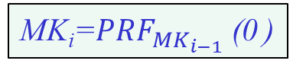
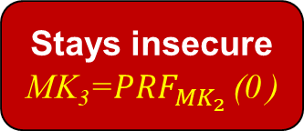
Forward Secrecy II
Forward Secrecy (FS): master key MK_{j} $⇏k_{i}(j>i)$
Session $i$ is secret even if any state of later sessions is exposed.
Uni-directional: ${\text{MK}}_{i}$ → ${\text{MK}}_{i+1}$ , but ${\text{MK}}_{i+1}$ → ${\text{MK}}_{i}$
How? Solution: PRF!
MK_{i}=${PRF}_{{MK}_{i−1}}$ (0 )
Secure MK₁
Keys Exposed
MK₂=${PRF}_{{MK}_{1}}$ (0 )
Stays insecure
MK₃=${PRF}_{{MK}_{2}}$ (0 )
$$k_{1}={PRF}_{{MK}_{1}}(N_{A}(1)||N_{B}(1))$$
$$k_{2}={PRF}_{{MK}_{2}}(N_{A}(2)||N_{B}(2))$$
$$k_{3}=…$$
26
Notes:
26
(c) Amir Herzberg, http://AmirHerzberg.com, Bar Ilan University
11/13/11
`Perfect’ is not really the right term… but that’s the commonly used term.

Slide 27
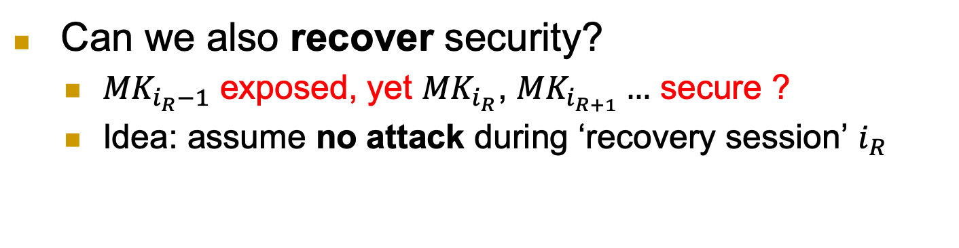
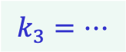
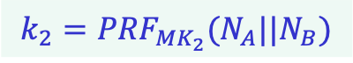
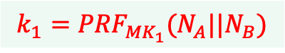
Recover Security
Can we also recover security?
${MK}_{i_{R}−1}$ exposed, yet ${MK}_{i_{R}}$, ${MK}_{i_{R+1}}…$ secure ?
Idea: assume no attack during ‘recovery session’ $i_{R}$
Keys Exposed
MK₁
No attack: recover !
MK₂
Stays secure
MK₃
$$k_{1}={PRF}_{{MK}_{1}}(N_{A}||N_{B})$$
$$k_{2}={PRF}_{{MK}_{2}}(N_{A}||N_{B})$$
$$k_{3}=…$$
27
Notes:
27
(c) Amir Herzberg, http://AmirHerzberg.com, Bar Ilan University
11/13/11
`Perfect’ is not really the right term… but that’s the commonly used term.

Slide 28
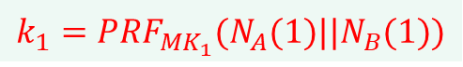
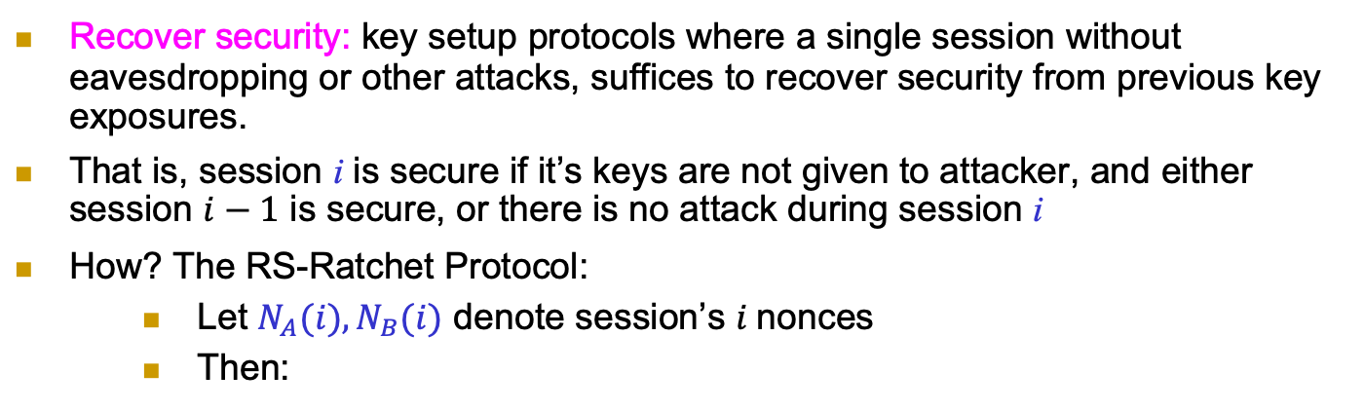
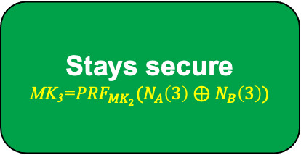
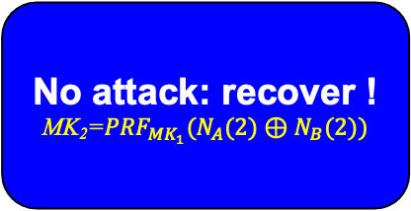
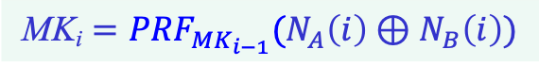

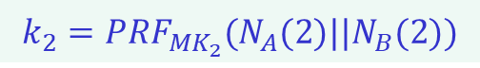
Recover Security (RS)
Recover security: key setup protocols where a single session without eavesdropping or other attacks, suffices to recover security from previous key exposures.
That is, session i is secure if it’s keys are not given to attacker, and either session $i−1$ is secure, or there is no attack during session i
How? The RS-Ratchet Protocol:
Let $N_{A}(i), N_{B}(i)$ denote session’s $i$nonces
Then:
$$\text{MK}\text{i}={PRF}_{{MK}_{i−1}}(N_{A}\left(i\right)⊕N_{B}\left(i\right))$$
Keys Exposed
MK₁
No attack: recover !
MK₂=${PRF}_{{MK}_{1}}(N_{A}(2)⊕N_{B}(2))$
Stays secure
MK₃=${PRF}_{{MK}_{2}}(N_{A}\left(3\right)⊕N_{B}\left(3\right))$
$$k_{1}={PRF}_{{MK}_{1}}(N_{A}(1)||N_{B}(1))$$
$$k_{2}={PRF}_{{MK}_{2}}(N_{A}(2)||N_{B}(2))$$
$$k_{3}=…$$
28
Notes:
28
(c) Amir Herzberg, http://AmirHerzberg.com, Bar Ilan University
11/13/11
`Perfect’ is not really the right term… but that’s the commonly used term.

Slide 29
Covered Material From the Textbook
Chapter 5
Sections 5.3 – 5.7 (except 5.7.3)

Slide 30

Thank You!

